Slide 1
Orange-Fish-Sundays Water Transfer Scheme
JM Viljoen
ALGOA TECHNICAL SUPPORT GROUP MEETING: 9th May 2018

Slide 2
PRESENTATION OUTLINE
Introduction
OFS flow and Dam level Monitoring
Great Fish Monitoring
Lower Sundays Monitoring

Slide 3
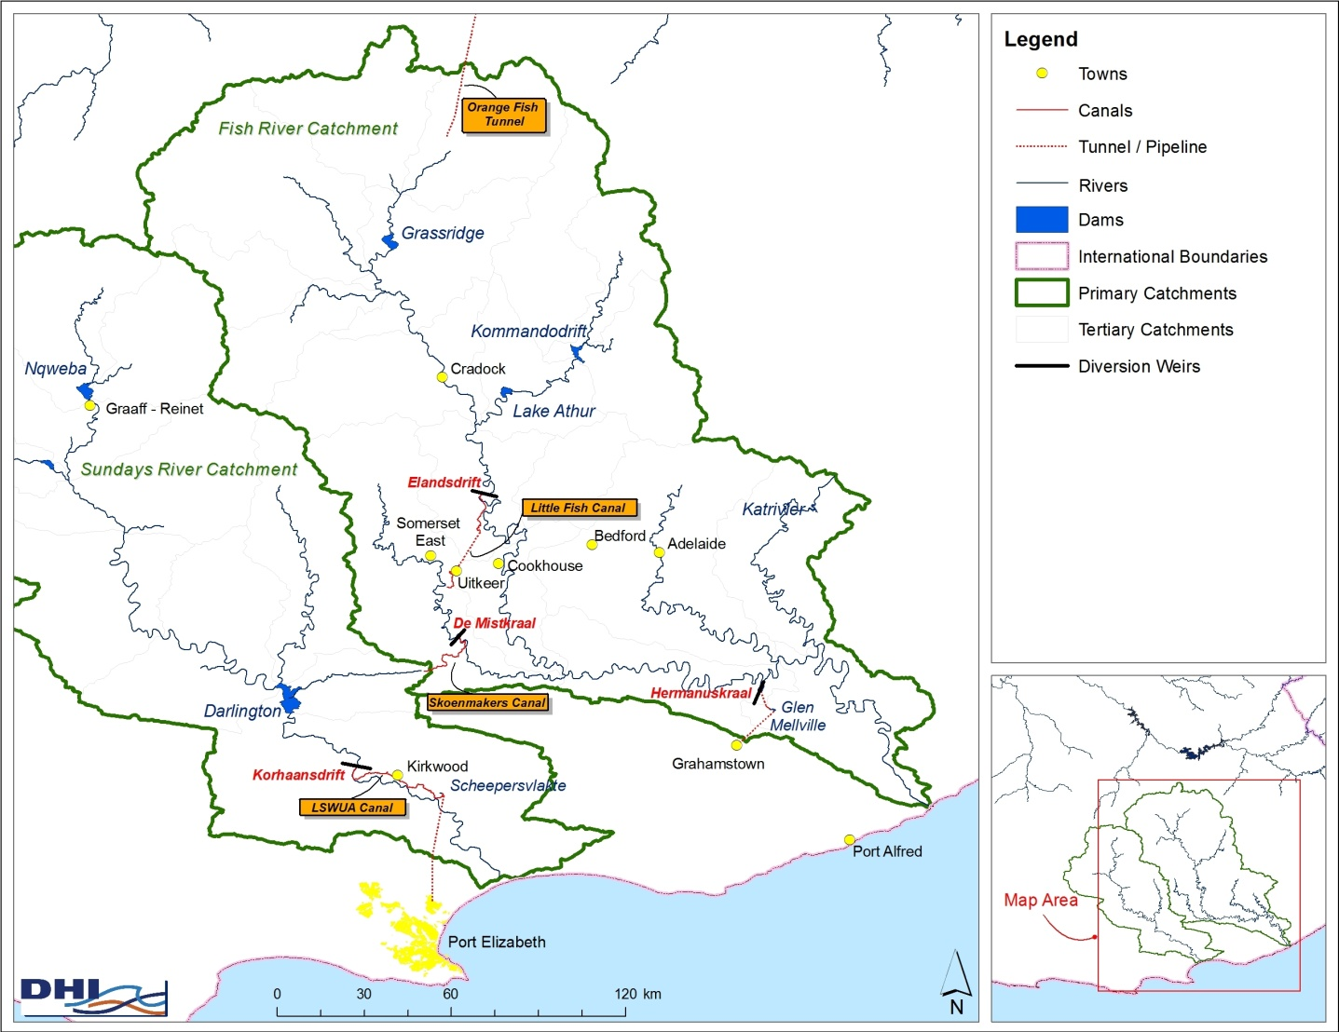
INTRODUCTION

Slide 4
INTRODUCTION
Characteristics
Fairly large system
> 1 000 km of tunnels, rivers and canals
2 reservoirs & 4 diversion weirs
> 150 water users
Approx. 48 000 ha of irrigation (Fish: 31 000 ha; Sundays 17 000 ha)
Volume ±700mil m³ / annum

Slide 5
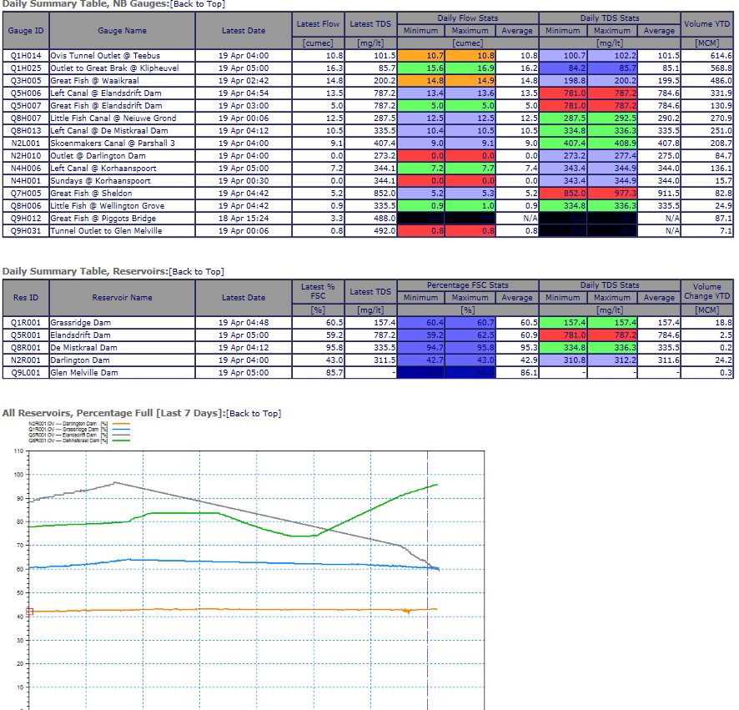
OFS MONITORING: DAMS & FLOWS

Slide 6
OFS MONITORING: DAMS & FLOWS

Slide 7
GREAT FISH MONITORING

Slide 8
GREAT FISH MONITORING

Slide 9
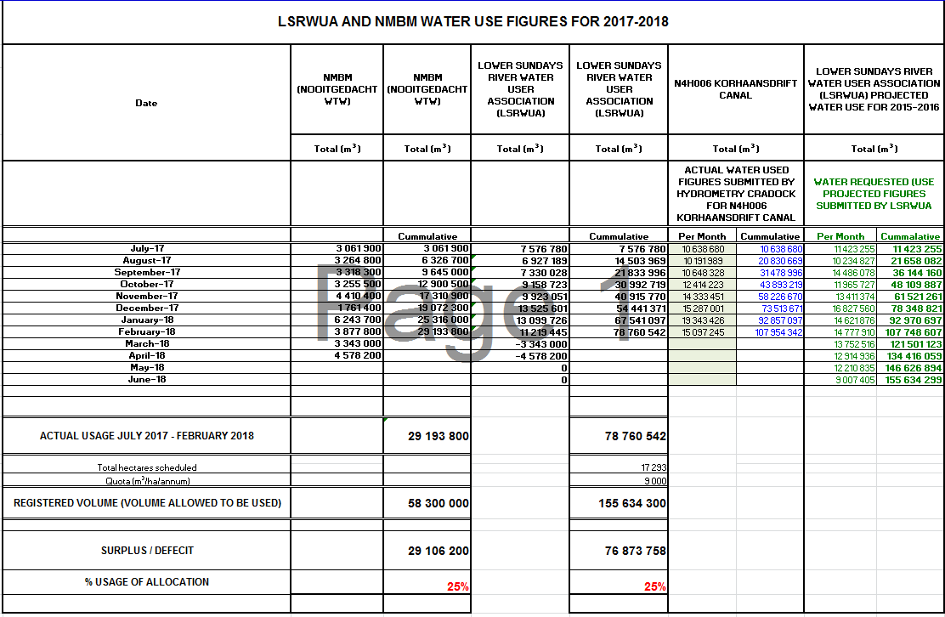
LOWER SUNDAYS MONITORING

Slide 10
LOWER SUNDAYS MONITORING

Slide 11
Thank you!

